Slide 1
HOSPITALITY DASHBOARD
GROUP-2
SAI KIRAN MEDISHETTI
REKHA CHOUDHARI
SIVAGNANAVATHI
LIKITHA SRINIVASAN
SUSMITHA SHAJI

Slide 2
INTRODUCTION
In this project, we performed an end-to-end analysis of a hospitality dataset using tools like MySQL, Excel, Power BI, and Tableau.
The goal was to uncover insights related to hotel revenue, booking trends, occupancy, cancellations, and platform performance.
The dataset includes booking details, hotel information, room categories, and time-based dimensions — allowing us to evaluate business performance from multiple angles.
By integrating SQL-based data cleaning, Excel-based summaries, and interactive dashboards in Power BI and Tableau, we present actionable insights that can support business decisions in the hospitality industry.

Slide 3
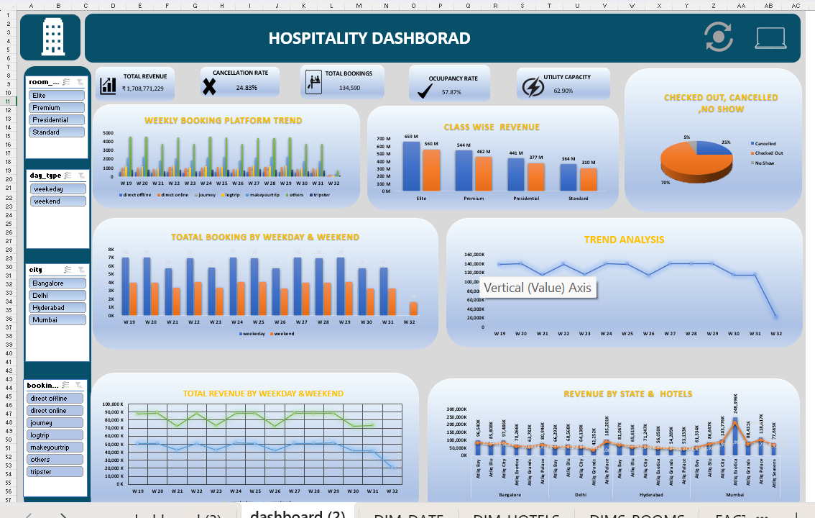
EXCEL DASHBOARD

Slide 4
CHALLENGES FACED
Date Format Mismatch – Faced date format mismatch across files, causing inconsistency.
Combining Multiple Sheets – Difficulty in combining multiple Excel sheets into one dataset.
Complex Filters and Visuals – Creating dynamic filters and visuals was complex.
Custom KPIs and Validation – KPIs required custom formulas and validation.
Data Cleaning – Spent time cleaning duplicates and missing values.

Slide 5
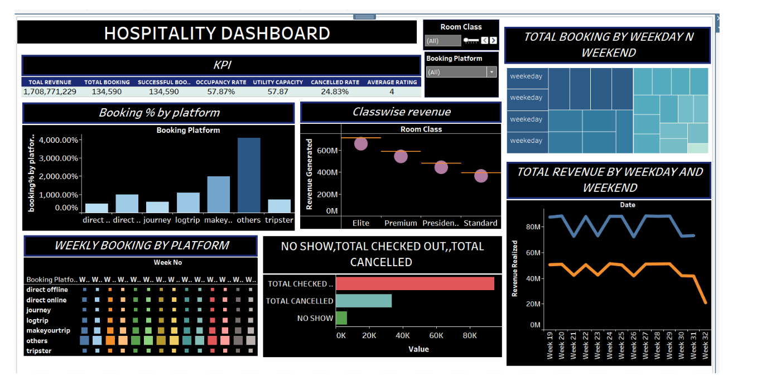
TABLEAU DASHBOARD

Slide 6
CHALLENGES FACED
Data Source Compatibility – Integrating data from various sources caused delays.
Slow Dashboard Performance – Large data slowed down dashboard responsiveness.
Limited Customization – Some visual elements were hard to customize as needed.
Complex Calculations – Building advanced calculated fields required extra effort.
User Interaction Issues – Setting up smooth interactivity between filters and charts was challenging.

Slide 7
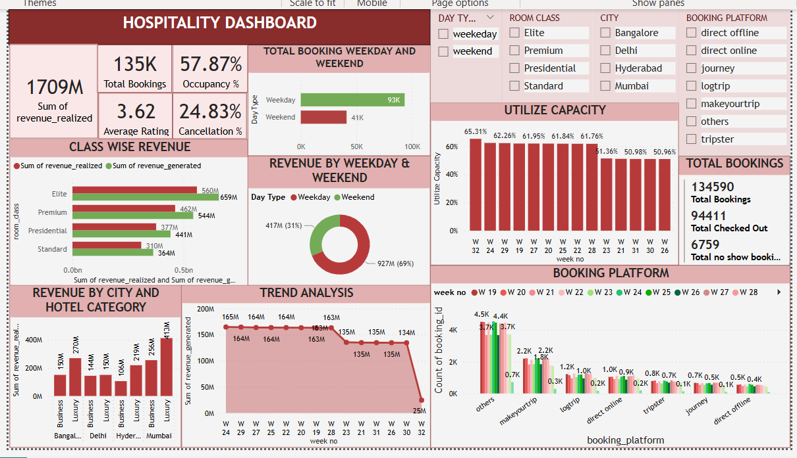
POWER BI DASHBOARD

Slide 8
CHALLENGES FACED
Data Cleaning – Handling missing or incorrect data took extra time to prepare the dataset.
Data Integration – Combining multiple data sources was complex and needed careful mapping.
Performance Issues – Dashboard was slow to load when working with large datasets.
Visual Design – Choosing the right visuals to clearly show insights was challenging.
User Requirements – Understanding and meeting all stakeholder needs required multiple revisions.

Slide 9
ANALYSIS
We analyzed the hospitality dataset across various dimensions like room class, city, booking platform, and check-in dates. The results showed that Elite and Premium rooms generate the most revenue, while MakeMyTrip and Tripster lead in online bookings. Major cities contribute heavily to both bookings and revenue. Most check-ins occur on weekends, especially Sundays. Overall, the project helped uncover key trends in revenue, occupancy, and cancellations using MySQL, Excel, Power BI, and Tableau.

Slide 10
Conclusion
Our hospitality data project successfully combined Excel, Tableau, Power BI ,and SQL to uncover valuable business insights from raw booking data.
Despite challenges with data formatting, integration, and dashboard performance,
we overcame them with structured cleaning, efficient modeling, and thoughtful visual
design.
The dashboards help identify high-performing cities, top revenue-generating room classes, seasonal booking trends, and platform-wise booking efficiency—empowering stakeholders to make data-driven decisions.

Slide 11


